Slide 1
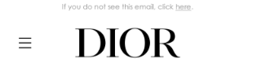
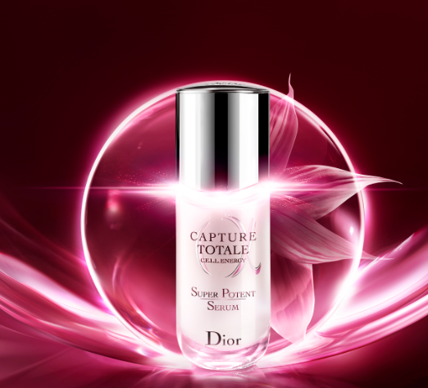
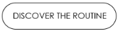
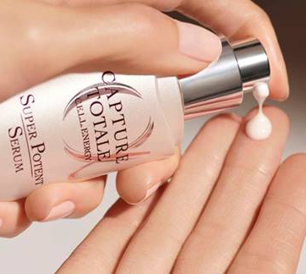
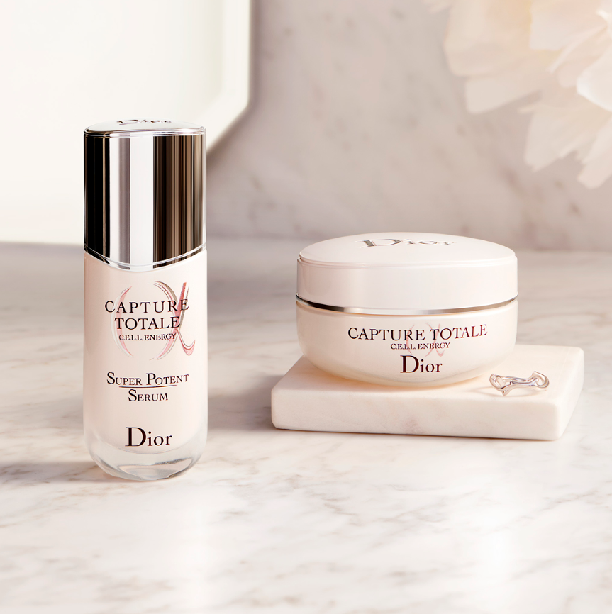
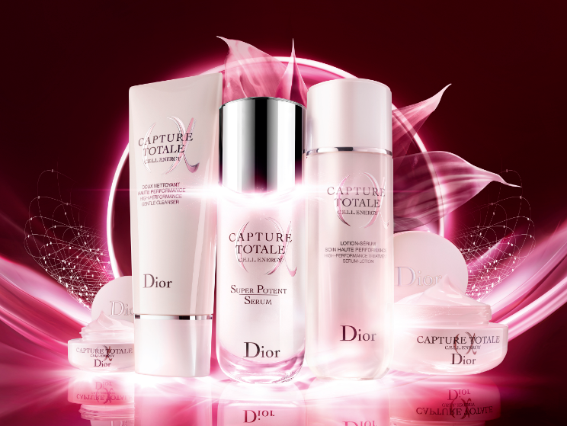
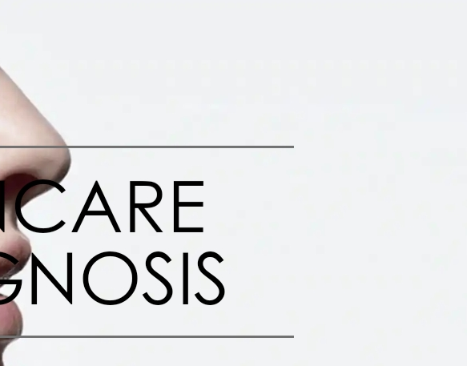
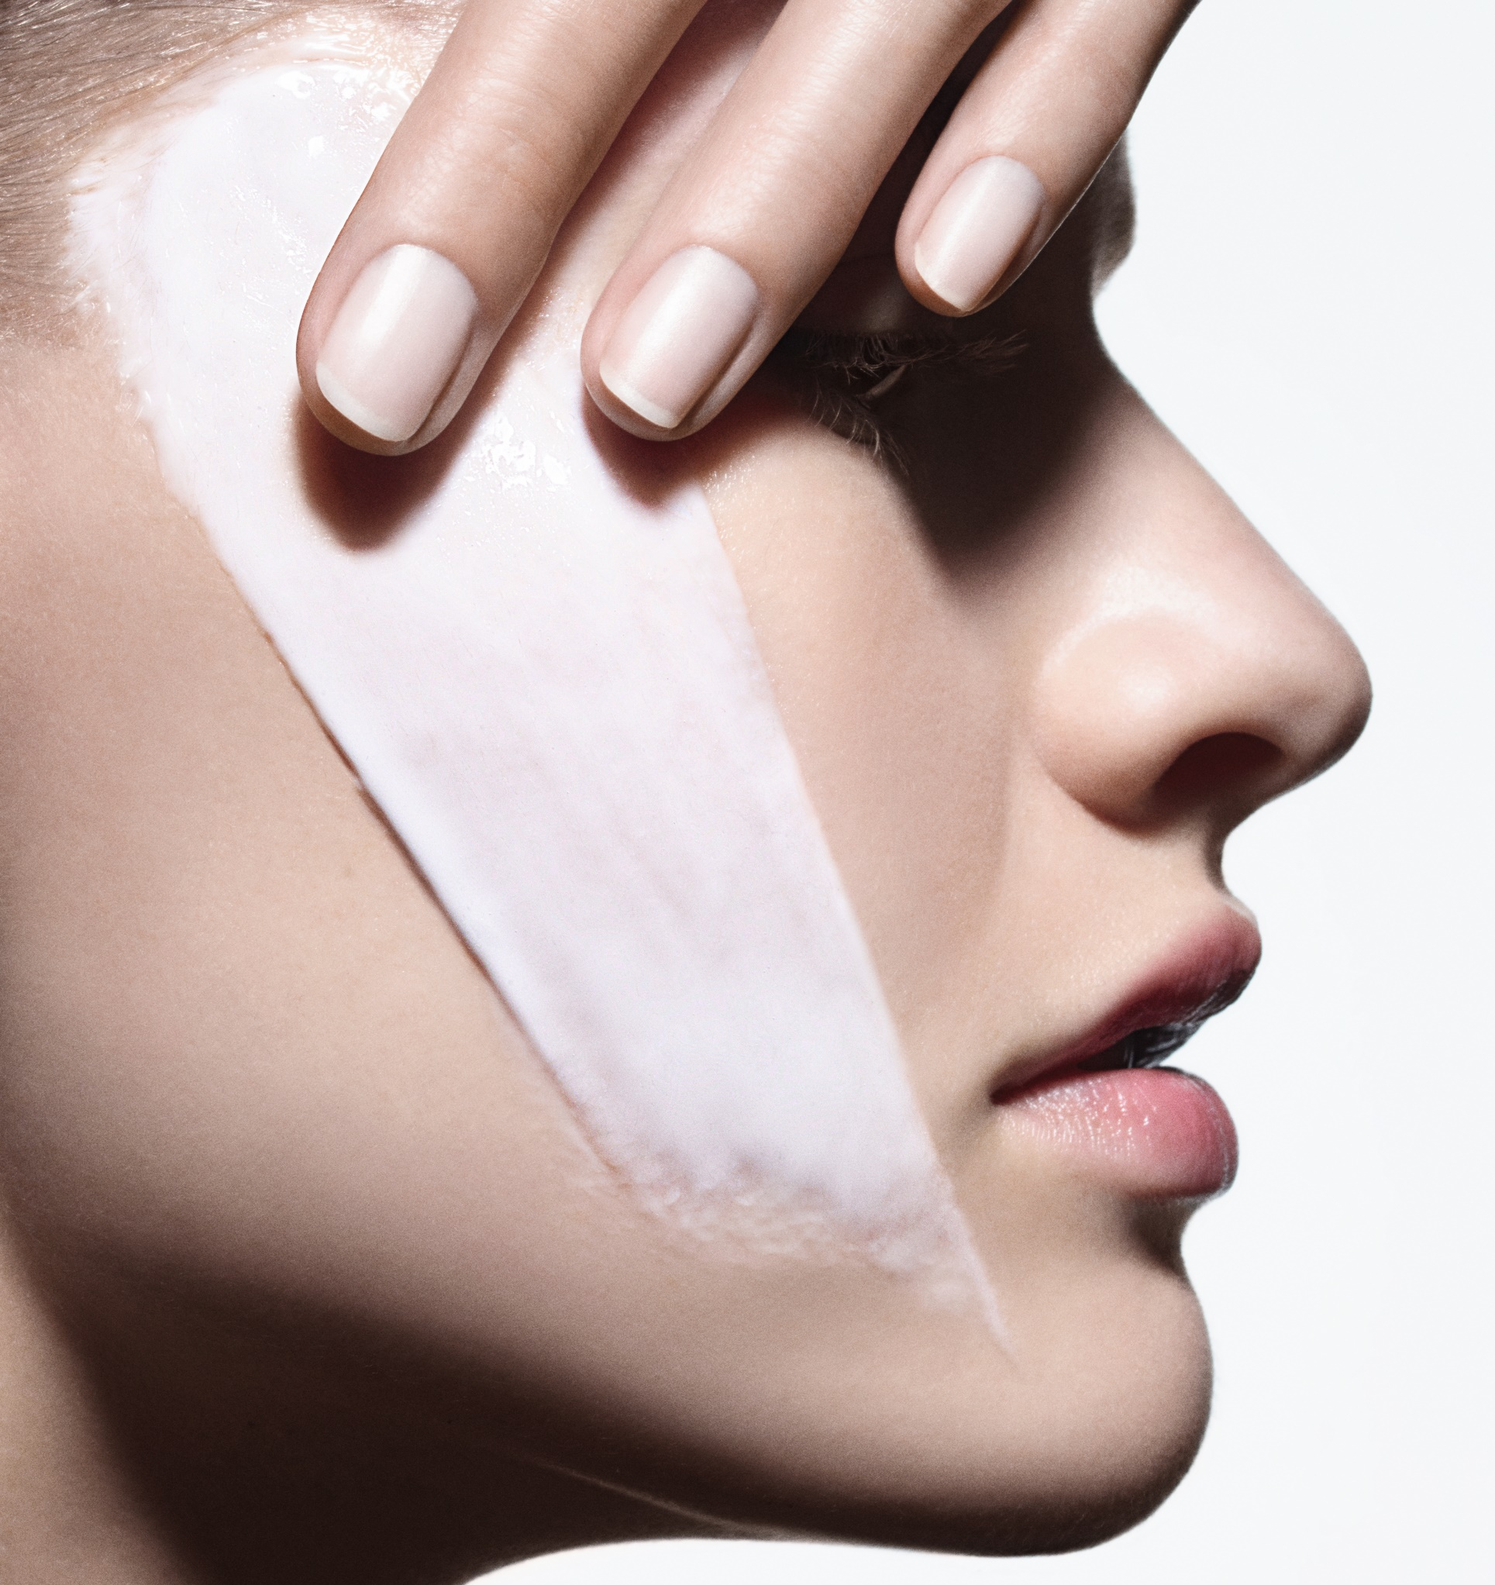
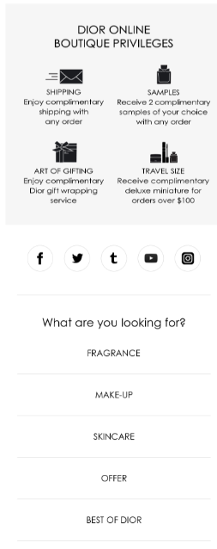
GLOBAL GUIDELINES
Every email element must be clickable
https://www.dior.com/en_int/skincare/the-collections/capture-totale
Product Page (Serum)
THANK YOU FOR PARTICIPATING
TO THE CAPTURE TOTALE EXPERIENCE
We hope that you have enjoyed the unique revitalizing power and sensory bliss of your sample of the Super Potent Serum, Dior’s best total age-defying serum.
DISCOVER
https://www.dior.com/en_int/skincare/caring-expert-tips/7-days-at-home-can-make-a-difference
Capture Totale
(with face massage video)
ACTIVATE THE INNER ENERGY OF YOUR SKIN IN ONLY 1 WEEK
With the SUPER POTENT SERUM, unleash your skin’s potency for a visible transformation: younger, stronger, healthier skin. To stimulate & intensify these benefits, discover our specific application gestures.
DISCOVER
https://www.dior.com/en_int/skincare/the-collections/capture-totale
Landing Page
Capture Totale
DISCOVER THE NEW TOTALE METHOD
Infuse your skin with a total age-defying program with the new Capture Totale 5-products range, which concentrates all the power of Dior’s mother cell and floral science expertise.
https://www.dior.com/beauty/en_int/th/diagnostic_soin.html
Landing page diagnostic
YOUR SKINCARE DIAGNOSIS
IN 2 MINUTES
Learn more about your skin features and discover your Dior customized skincare program to enhance your skin’s beauty.
LET’S START!
START

